Slide 1
ERASMUS +
The textile department

Slide 2
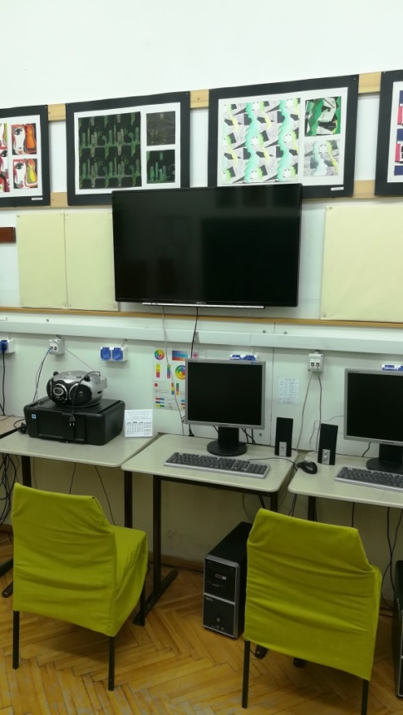
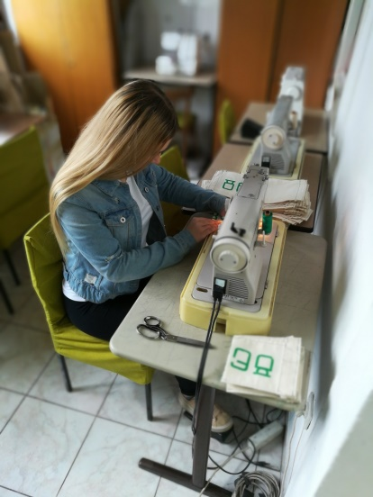
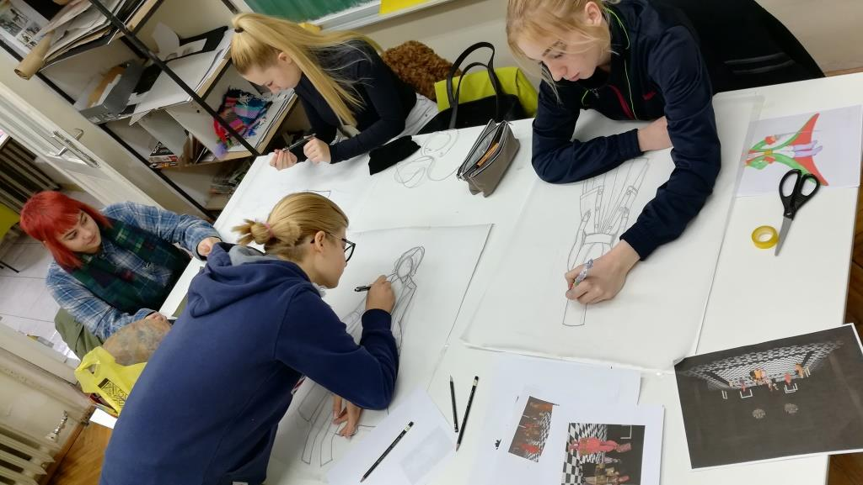
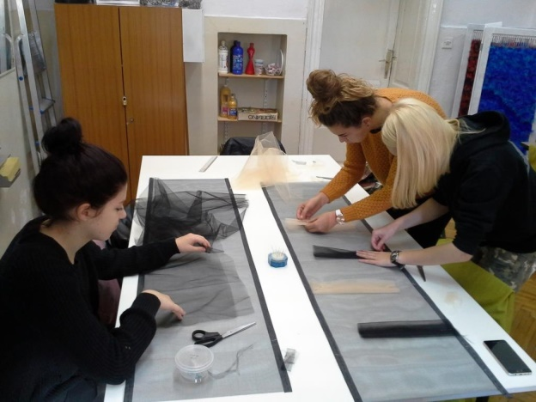
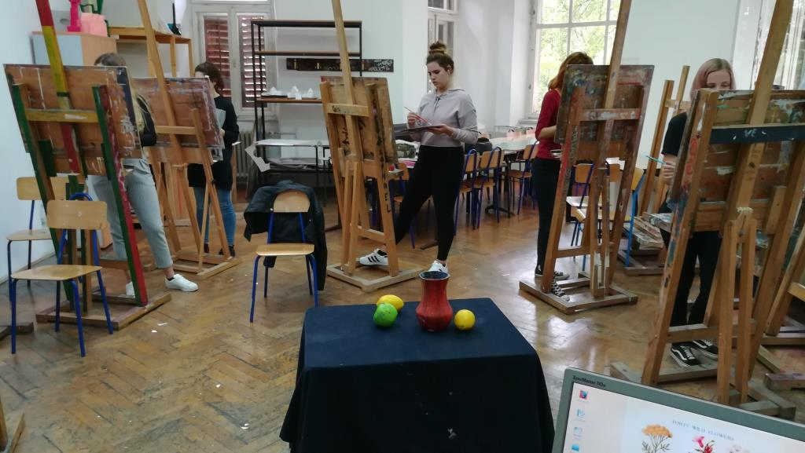
Textile design department in ŠPUD Pula
Making and designing textile and clothes
Combining modern and traditional tehniques

Slide 3
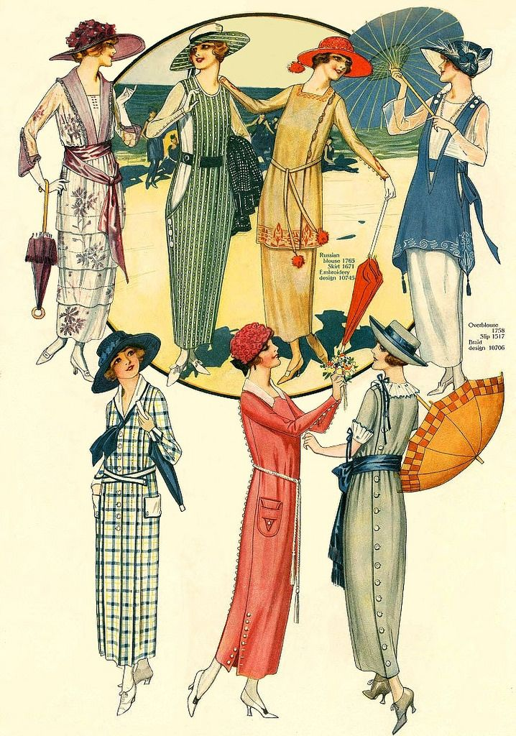
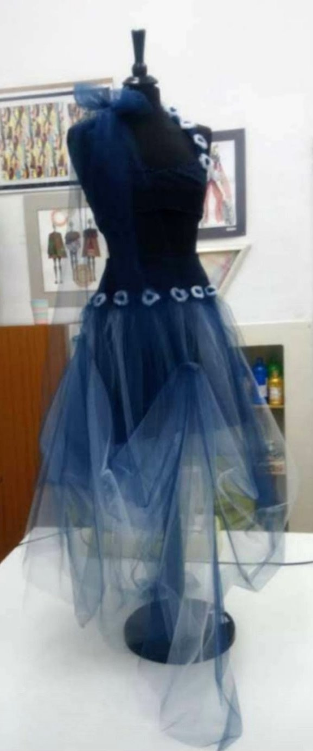
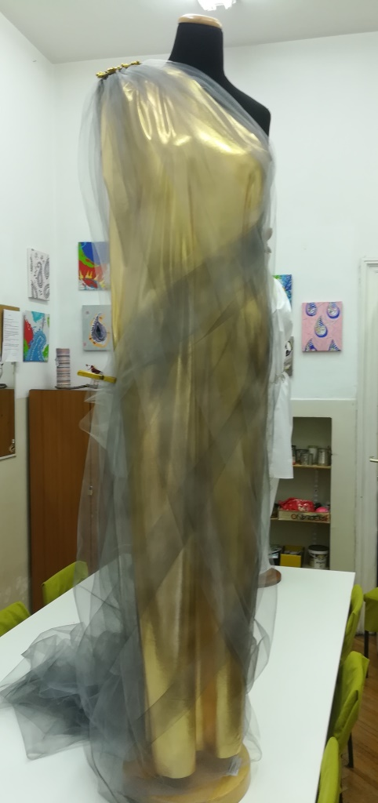
History of texTile And costume and clothing making
Students gain knowledge about fabrics and clothes through history
Students learn about the basic techniques of clothes sewing and various usable items according to their ideas

Slide 4
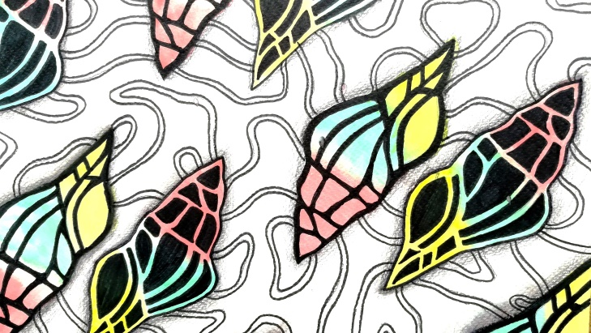
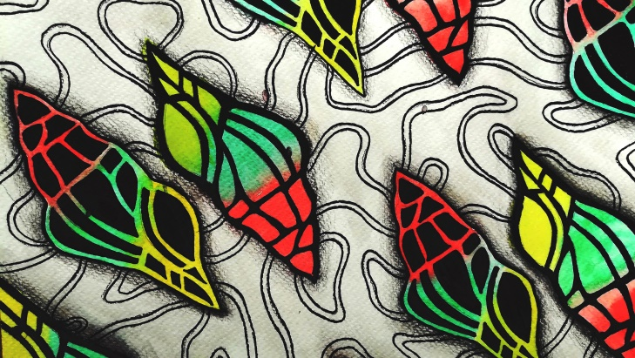
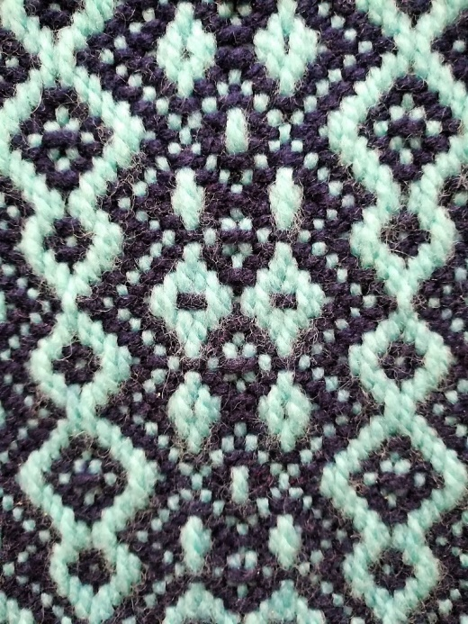
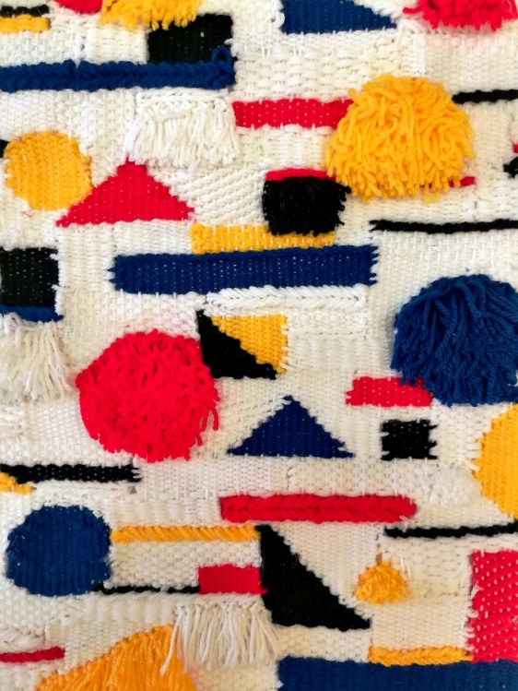
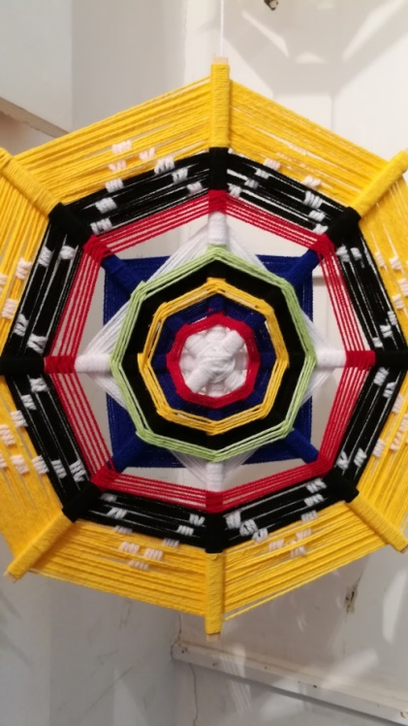
Textile projection And weaving teChniques
Artistic design of patterns through the principles of composition, proportion, texture and colour
Making of fabrics and woven items using modern and traditional weaving techniques

Slide 5
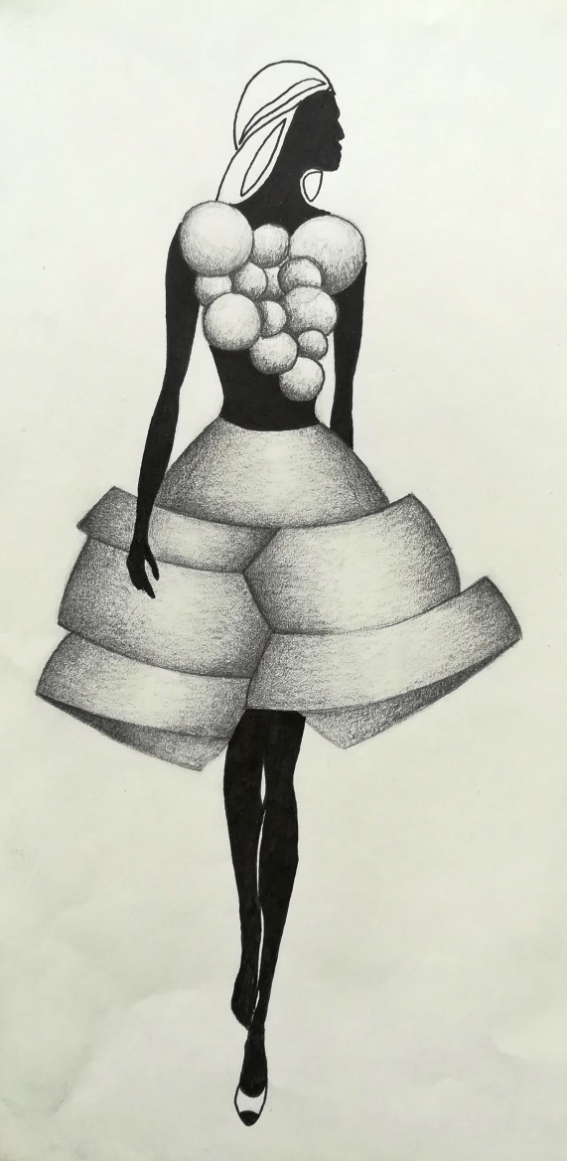
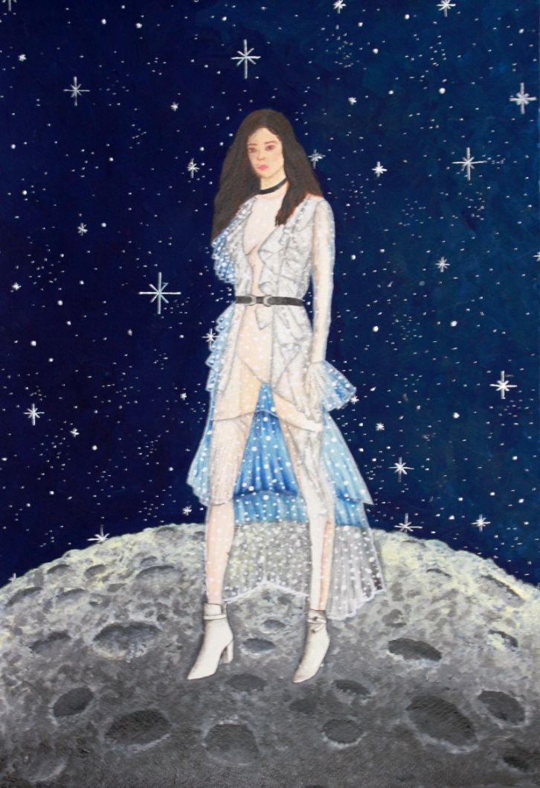
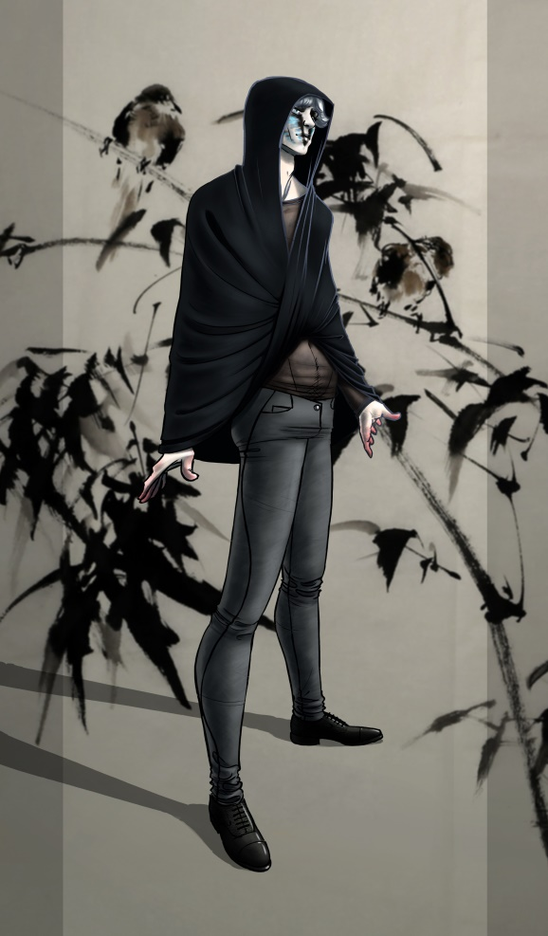
Fashion drawing and painting
Students learn about the figure proportions and the use of visual language with the goal of independent creation of clothing collections

Slide 6
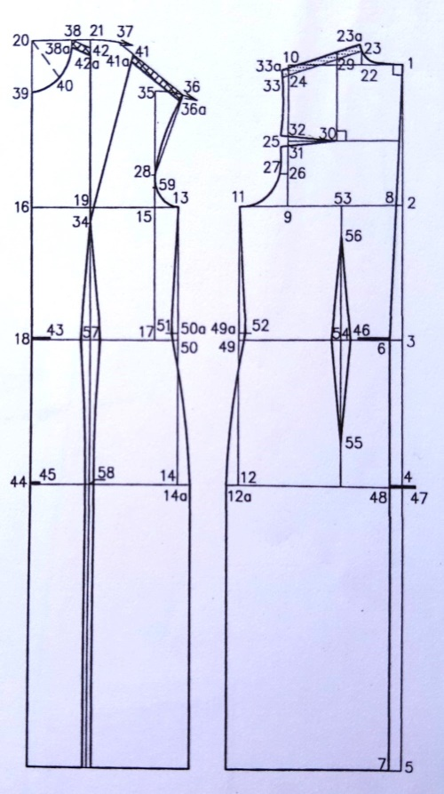
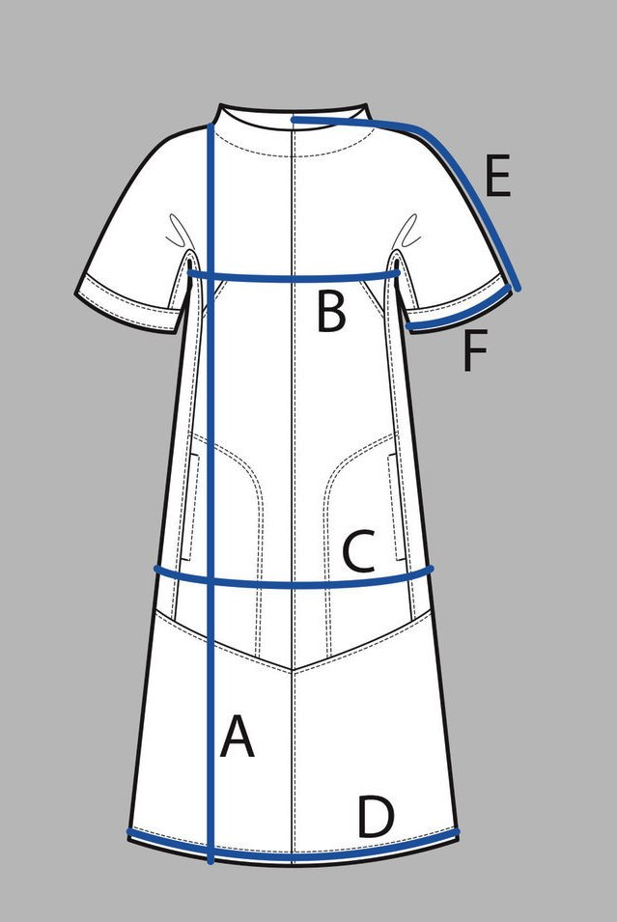
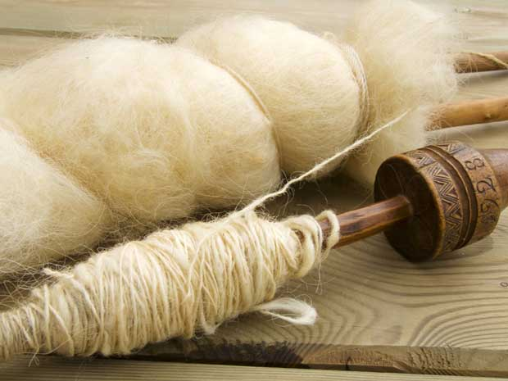
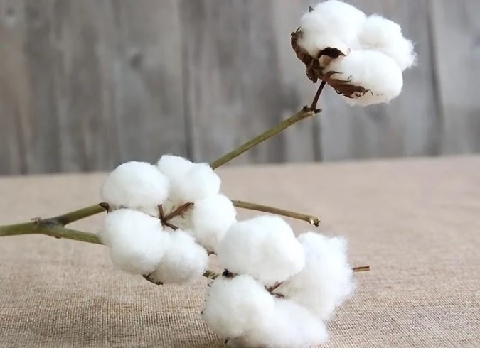
Clothing construction and textile teChnology
Proper way of taking body measurements
Acquiring knowledge about the kinds and ways of getting yarn of which fabric is made

Slide 7
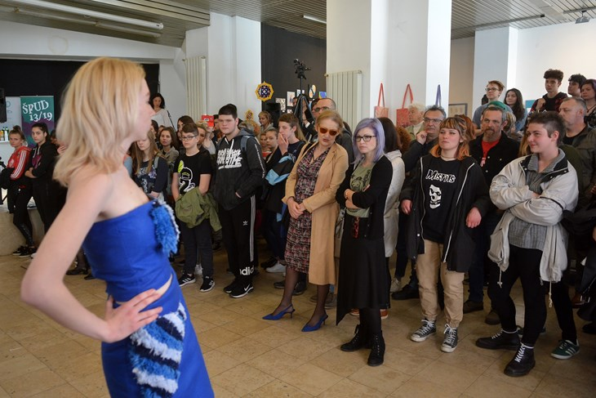
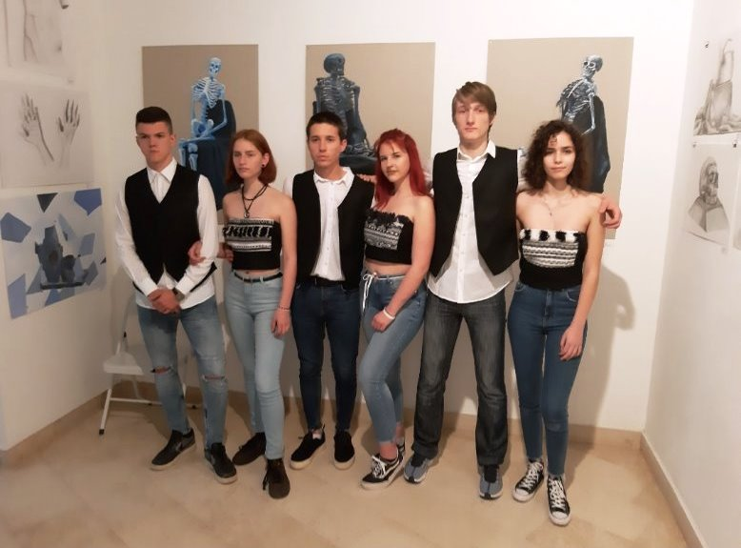
STUDENTS From textile department
Works and creations usually are shown on school exibitions and various manifestations in the town

